Slide 1


UNIT-II(Descriptive Analytics)
Dr. Parthasarathi Pattnayak

Slide 2
A High-Level Architecture of BI.

Slide 3
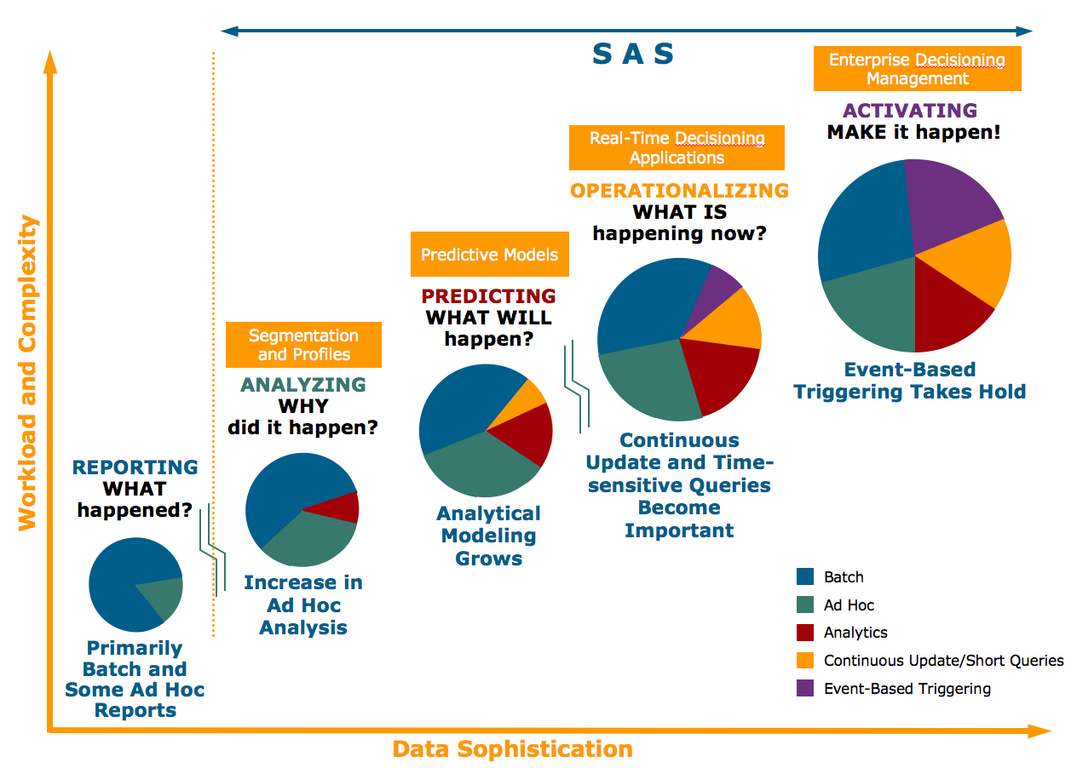
Evolution of DSS & DW

Slide 4
Decision Making and Analytics
Analytics
Descriptive Analytics
Predictive Analytics
Prescriptive Analytics

Slide 5
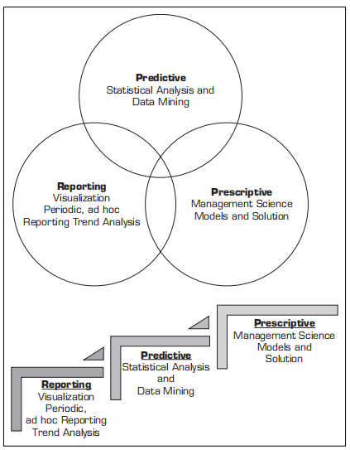
Decision Making and Analytics

Slide 6
A Conceptual Framework for DW

Slide 7
Generic DW Architectures
3-tier
architecture
2-tier
architecture
1-tier
Architecture
?

Slide 8
A Web-based DW Architecture

Slide 9
Alternative DW Architectures

Slide 10
Alternative DW Architectures

Slide 11
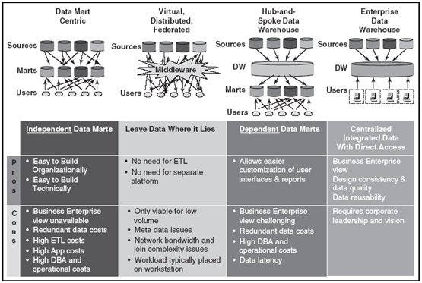
Alternative DW Architectures

Slide 12
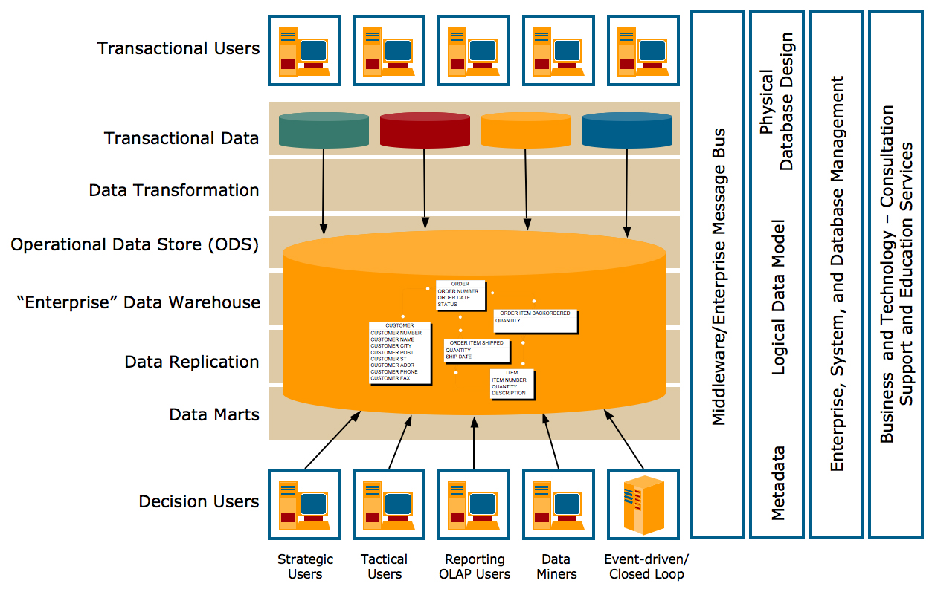
Enterprise Data Warehouse (by Teradata Corporation)

Slide 13
Data Integration and the Extraction, Transformation, and Load (ETL) Process
Extraction, transformation, and load (ETL) process

Slide 14
DW Structure: Star Schema (Dimensional Modeling)

Slide 15
OLAP
Slicing Operations on a Simple Three-Dimensional
Data Cube

Slide 16
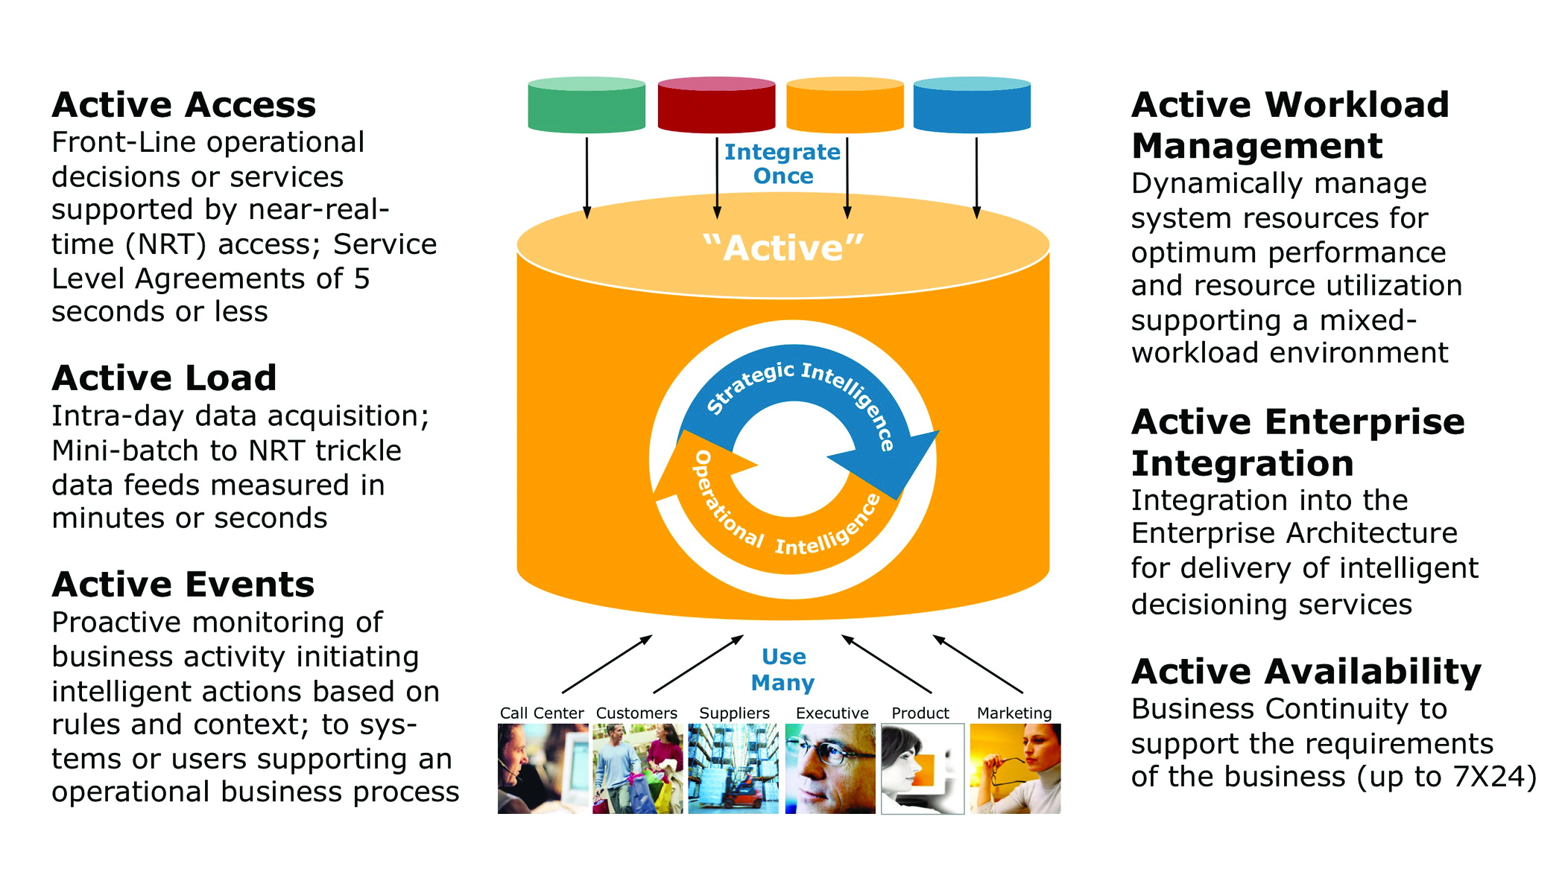
Real-time/Active DW at Teradata

